Slide 1
Y13 Next Steps

Slide 2
Revision and stress
Feeling stress is normal – in fact SOME is helpful
Routines help to reduce it – try to encourage it
Organisation is key to preventing panic
Be realistic – don’t set themselves up for failure
Actually have a break – don’t do both
Be flexible – if it’s not working – stop try again later

Slide 3
Time | 8 | 9 | 10 | 11 | 12 | 13 | 14 | 15 | 16 | 17 | 18 | 19 | 20 | 21 | 22
Mon. |  |  |  |  |  |  |  |  |  |  | Training
Tues.
Wed. |  |  | Coffee |  |  |  |  |  |  |  | Training
Thurs |  |  |  | Gym
Fri
Time | 8 | 9 | 10 | 11 | 12 | 13 | 14 | 15 | 16 | 17 | 18 | 19 | 20 | 21 | 22
Sat |  |  | Tournament |  |  |  |  |  |  |  |  |  |  | Out
Sun

Slide 4
Time | 8 | 9 | 10 | 11 | 12 | 13 | 14 | 15 | 16 | 17 | 18 | 19 | 20 | 21 | 22
Mon. | Photosyn | alkanes | Trig | Immuity | Maths T2 | PP Biol | Maths T3 |  |  |  | Training
Tues. |  |  |  | Inheri | Transport | Orgaanic T1 | PP Math | respir | DNA | Epi | PP Chem
Wed. |  |  | Coffee |  | Maths PP | Chem p1 T3 |  |  |  |  | Training
Thurs |  |  |  | Gym
Fri
Time | 8 | 9 | 10 | 11 | 12 | 13 | 14 | 15 | 16 | 17 | 18 | 19 | 20 | 21 | 22
Sat |  |  | Tournament |  |  |  |  |  |  |  |  |  |  | Out
Sun

Slide 5
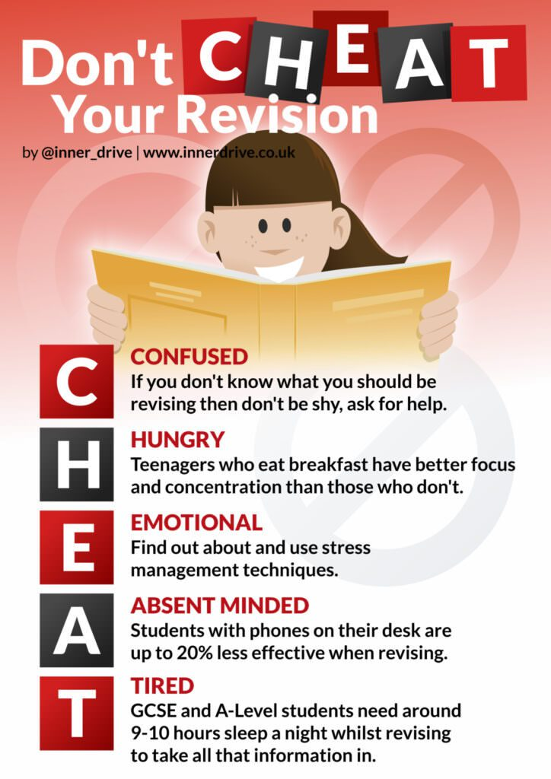

Slide 6
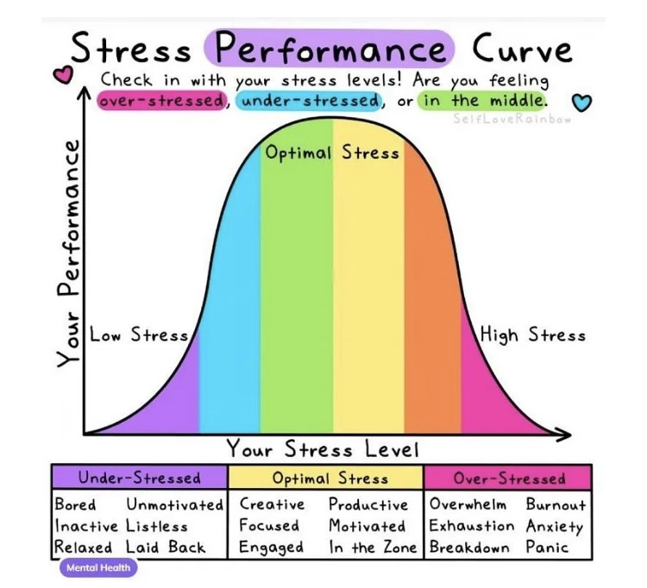

Slide 10
Exam Arrangements
Students must double check timetable and have a picture of it on their phone. Any clashes or errors should be addressed with Mrs Hill- Jones- Exams manager o receipt of exam timetable
Check the start time, location and seat number, arrive early – 15 mins prior to start time
Normal dress, equipment and ID needed
Unlike mocks students will not get another chance to sit the exam. If a student feels ill on the day they must bring it to the attention of the exams officer ASAP- before the exam.
ANY ISSUES during the exam students must bring it to the attention of the invigilators immediately.
Students that have access arrangements, this must be their normal way of working. Consider alternative arrangements to get home

Slide 11
UCAS and Mock exam results
Use Mock results to guide firm choice and backup choice
Backup choice must be one that students are willing to study and should be in line with original predicted grades
Be Realistic- no point choosing somewhere that wants 3 x A* grades if you are achieving three C grades.
HAVE A BACKUP PLAN (career advisor available)
Must make decision by June 5th
Deferring? Don’t need to do it now.

Slide 12
Is open to students that have not received any offers.
A good place to start is using the UCAS website to search which universities still have places available or give admissions a call at a specific University.
Students can only apply to one University at a time
Universities have up to three weeks to review the application.
Extra is now open and closes on July 4th

Slide 13
Once Extra has closed clearing opens to view courses, however, can’t apply for course until results day
Gives students the chance to look at Universities that have places available. There will be more on results day.
Is good to check out those places online or arrange a visit if possible.
Advisable not to be on holiday on results day as it can very stressful if students need to access clearing.
Important to make an informed decision rather then a knee jerk reaction- remember that it is costing £9535
Loads of information can be found on the UCAS website including advise for parents.

