Slide 1
Parents UCAS Meeting
Security marking: PUBLIC
18 April 2024
| 1

Slide 2
Summer Programme
Wk | Date | Activity
A | 19 April | Why apply to university/choosing a course Alternatives to university
B | 26 April | Subject/careers fair – at stated time Unifrog Task – when not at fair
A | 3 May | Subject/careers fair – at stated time Unifrog Task - when not at fair
B | 10 May | ASK Apprenticeship talk Unifrog Task/research
A | 17 May | UCAS Application Overview Complete UCAS application form Trip to Edgehill University
Wk | Date | Activity
A | 7 June | Writing a Personal Statement Work on Personal Statements UCAS Conference: Liverpool
B | 14 June | Interview Skills Writing personal statement/Researching courses
A | 21 June | EXAMS
B | 28 June | Student Finance talk Study Abroad opportunities
A | 5 July | WORK EXPERIENCE WEEK Work on UCAS forms and personal statements
A 9 June
B | 12 July
B | 24 May

Slide 3
Choices available
Whether students are certain of what they want to do when they leave Sixth Form, or have no clue at all, it’s a great idea to explore all of the options available.
Higher education
Apprenticeships/ traineeships
Studying abroad
Gap year
Getting a job
Understand the options available by using UNIFROG and ucas.com
| 3

Slide 4
What is UCAS?
350+ universities and colleges:
  4 in Northern Ireland
  15 in Wales
  19 in Scotland
  324 in England
  35,000+ courses available
| 4

Slide 5




UCAS key facts
Online application – opens 9th May
Maximum of five choices
Choice restrictions:
  medicine, veterinary, medicine/science, dentistry
  (maximum of four)
  Oxford OR Cambridge
Cost – £27.50
Invisibility
5
| 5

Slide 6
Application Timeline 2024 Entry
16th May UCAS Undergraduate apply opens (can submit from 6th September)
12th July UCAS Conservatoires application open
18th September Internal deadline for fast-track applications (medicine, veterinary medicine/science, dentistry, and ALL courses at Oxford or Cambridge)
2nd October Closing date for conservatoires music applications
16th October UCAS application deadline for Fast track courses
20th October Internal deadline for ALL applications (before half term)
31st January UCAS application deadline/most conservatoires dance/drama/musical theatre applications
28th February Extra opens (for students who have no offers from all 5 choices)
30th June Last date for late/extra applications before Clearing
| 6

Slide 7
Completing the UCAS application
UCAS FORM including:
1. Personal details
2. Additional information
3. Student finance
4. Education
5. Employment
Checked by enrichment staff – should be completed BEFORE summer
Form tutor will check and approve personal statements before the student will
PAY AND SEND - the application will not go directly to UCAS! Form tutor THEN writes Reference.
Sixth Form team check form, personal statement and reference (including predicted grades).
Applications are sent to admin who check grades before approval by Mrs Marley
Register at: ucas.com/apply
Universities/ colleges make their decisions
Once approved, Applications are sent to UCAS
PLEASE NOTE: This process takes a long time given the number of checks and number of application being processed and is dependant on student response time.
| 7

Slide 8



Decisions
Universities and colleges will review the:
And make one of three decisions:
They may also ask for:
personal statement
    Unconditional offer
Admissions test
qualifications
    Conditional offer
Interview
    Unsuccessful
Reference (including predicted grades
Portfolio/audition
These are the students responsibility!
Security marking: PUBLIC
18 April 2024
| 8

Slide 9
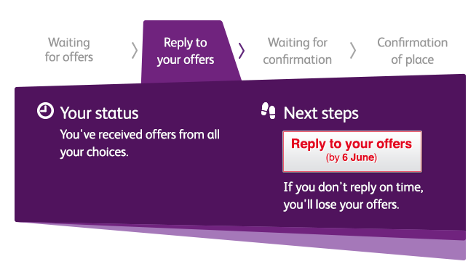

Tracking applications
Track allows applicants to:
follow the progress of their application 24/7
see their choices and personal information
view their offers
reply to offers online
In Track, a student can hold up to two offers:
  firm – if they meet the conditions of the offer they will be placed here
  insurance –if they are not placed with their firm choice, they may be placed with their insurance choice.
| 9

Slide 10

Other options
Extra (Feb – Jun)
  Used all five choices and had no offers
  Add Extra choices for consideration one at a time in Track
Clearing (Jul – Oct)
Apply after 30 June, receive no offers, decline all offers, not met conditions
Find vacancies from July – opens on results day
Security marking: PUBLIC
| 10

Slide 11
What should Students be doing now?
Researching - universities and courses and where this will lead
Preparation for writing personal statement:
- Wider reading - go beyond the syllabus
Complete a mooc/s (massive open online course)
Work experience (virtual if necessary)
Attending online information sessions for courses/subject areas/universities
Looking out for/attend open days
Focusing on A-level studies – End of Year exams start Monday 19th June!

Slide 12

The Unifrog Tools
Drafting application materials
Exploring pathways
Searching for
opportunities
Recording what you’ve done
Making applications
Careers library
UK universities
Activities
Personal Statement
Post 16/18 Intentions
Subjects library
US universities
Competencies
CV / Resumé
Locker
Know-how library
European universities
Interactions
Teacher References
Applications list
MOOC
Oxbridge
Common App Essay
Apprenticeships
College/ Sixth Form
Canadian universities
Asian universities
Special Opportunities

Slide 13
Predicted Grades
Based on all evidence from Y12
Already Aspirational
Change can be requested via parental consent and completion of form
Reasons for change needs to be provided
Not recommended to change by more than 2 grades overall
Students MUST have a back up option in line with original grades

Slide 14
How can you support them?
Research
Use the parents/guardians’ section of the UCAS website at www.ucas.com/parents and unifrog.
Sign up
Sign up for updates from UCAS, and get everything you need to know about the application process direct to your inbox.
Open days
Attend virtual events and open days – you may have a different perspective.
Be proactive
Make sure they read everything carefully that is sent to them and don’t book family holidays at key times!
| 14

Slide 15
Dates to Remember
Research and preparation should have begun!
Students start completing UCAS form on 17th May
Personal statements – aim to submit first draft BEFORE summer
Fast track internal deadline is 18th September
Internal deadline for ALL applications is BEFORE half term
If students fail to meet these deadlines they risk their application being sent to UCAS late! The later they submit, the longer the checking process will take
EOY exams start 19th June – important for predicted grades

Slide 16
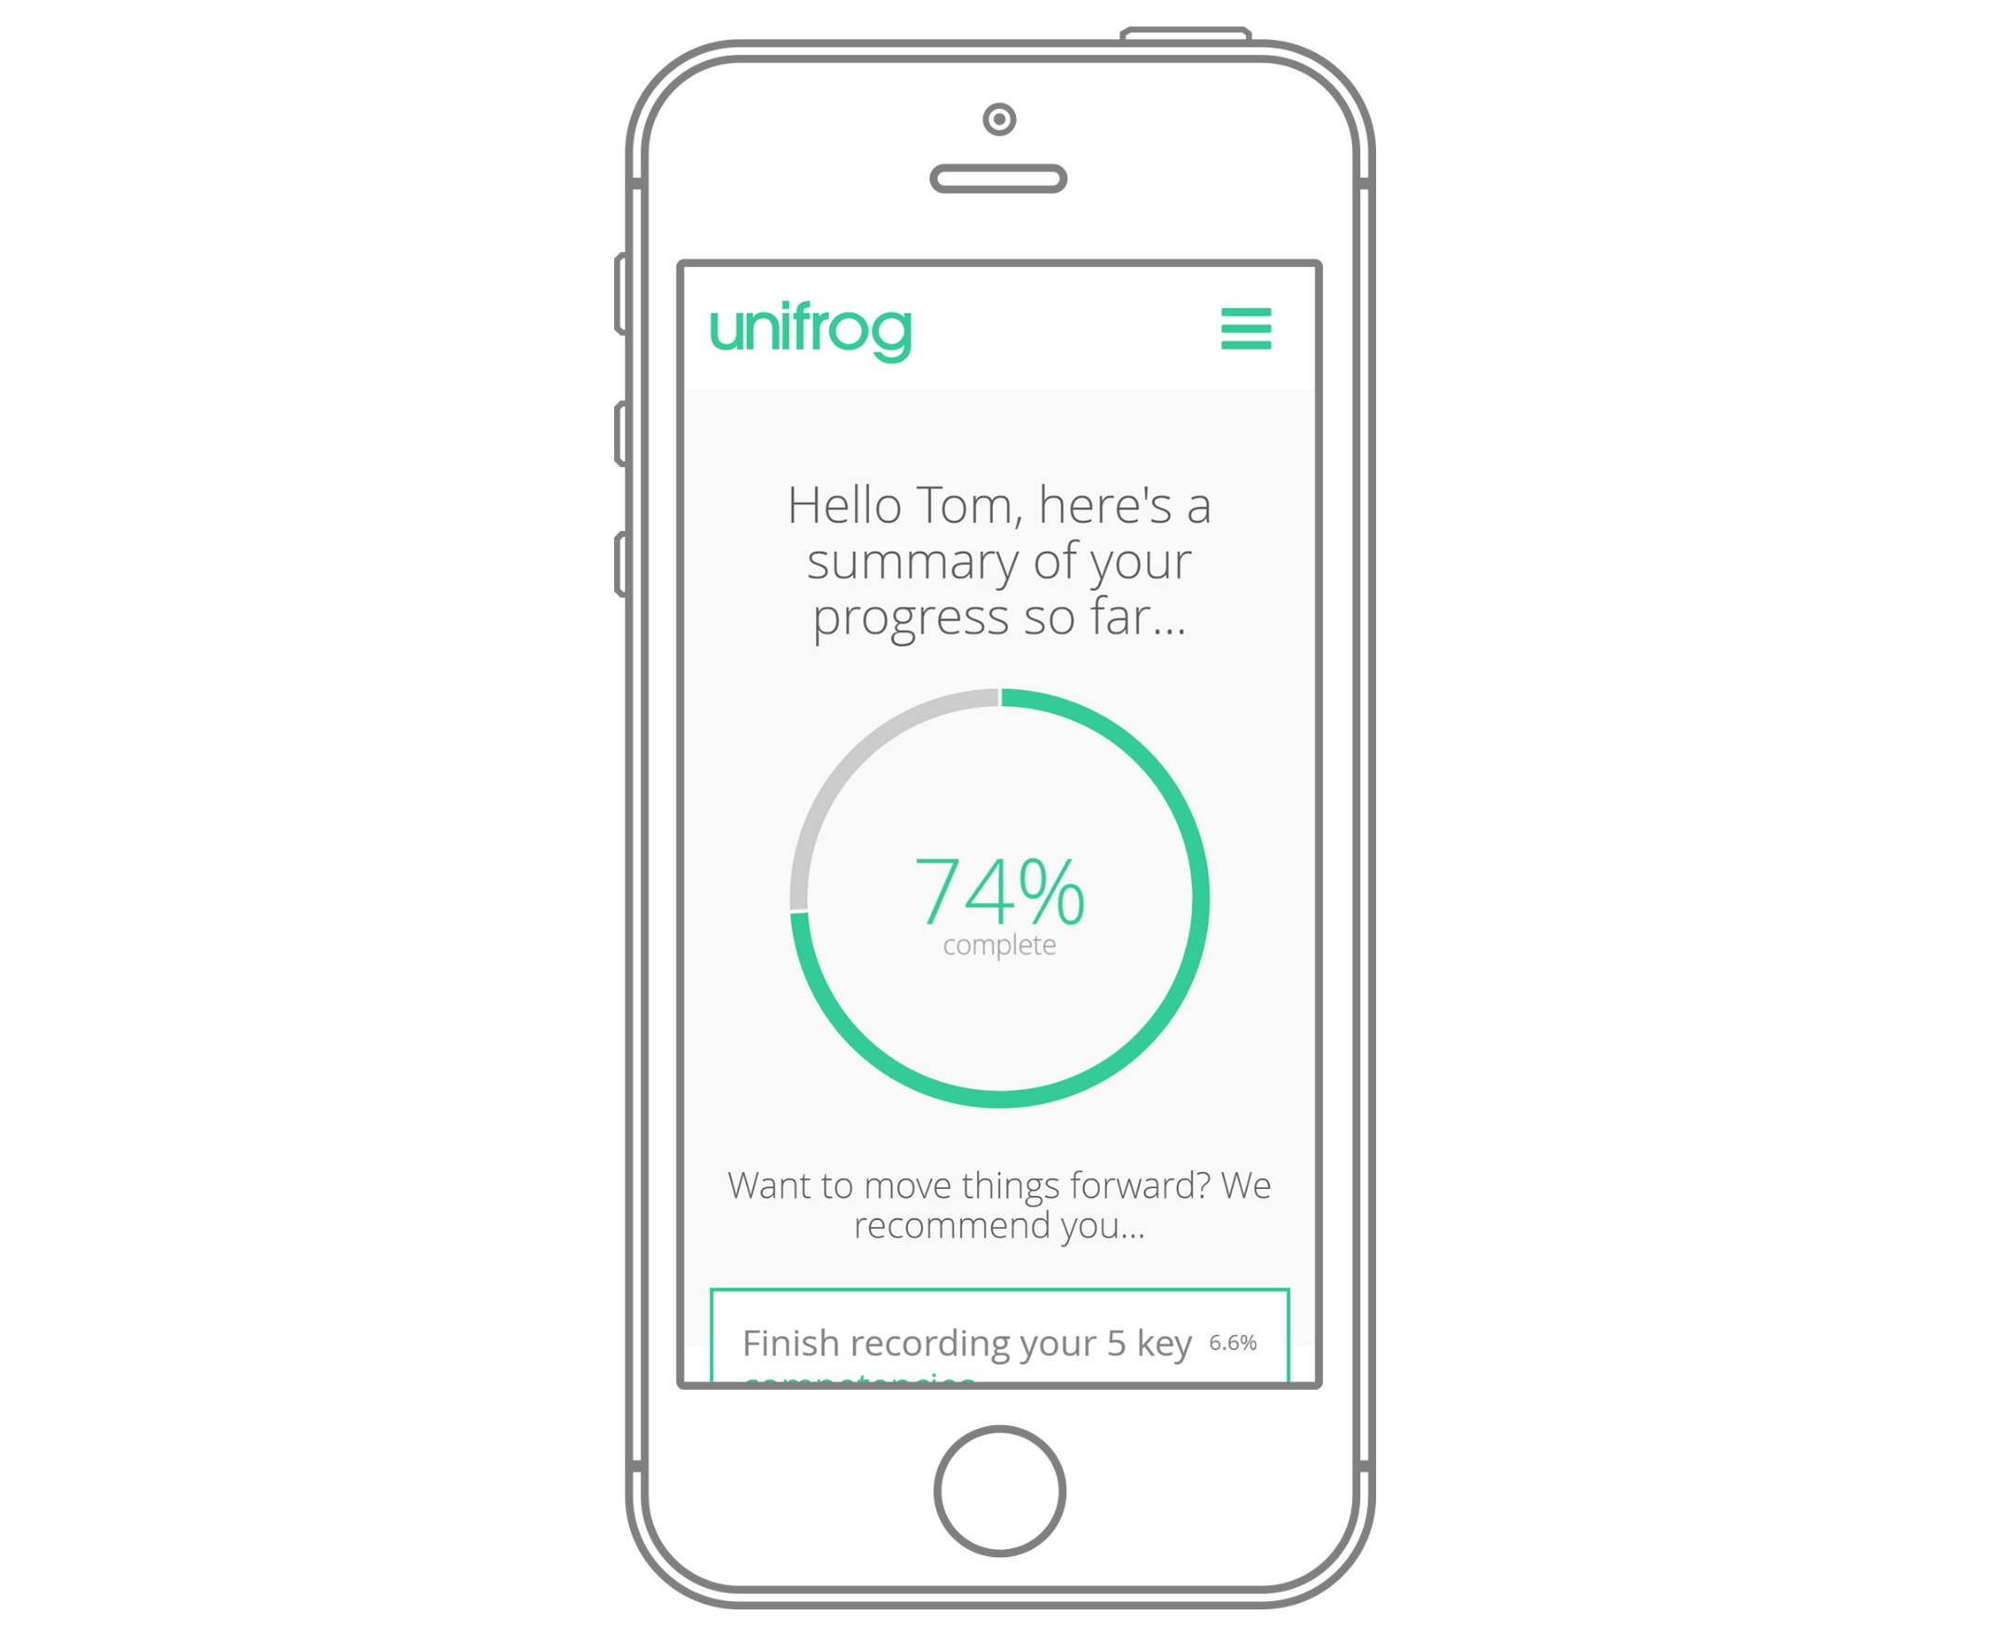
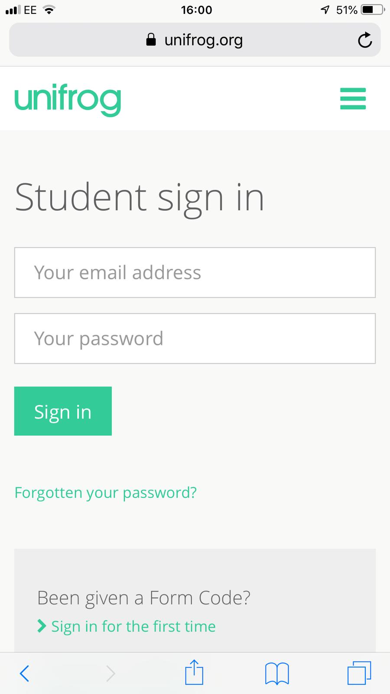
Parents & guardians, get signed up!
Go to www.unifrog.org/student and click ‘Sign in for the first time’
You’ll be asked for some details and a form code. This is what you need:
WKGSparents
After signing up, log into Unifrog using your email address and password via the student sign-in page.

Slide 17
Any Questions?
Security marking: PUBLIC
18 April 2024
| 17

