Slide 1
A LEVEL
ART & DESIGN
AQA - Fine Art
AQA - Graphic Communications
AQA - Textile Design

Slide 2
The Art Department at WKGS aims to produce the very best artists and designers. We challenge learners through teaching and learning to strive to reach their full potential and become visually and artistically literate in their chosen specialism.
A-level Art and Design courses allow learners to develop independent working and creative thinking. Problem-solving and the ability to work and think independently are key skills in the world of work. Through a creative subject, learners learn how to research, apply and present their ideas and thoughts creatively. These skills are important life skills and also can be applied to any future career path that our learners decide to follow.

Slide 3
Year 12
Sep - Feb
In Year 12 : You will learn a range of skills and techniques whilst developing work within your subject specialism for a given theme,
Year 12 Project 1– Nostalgia theme, looking at a particular decade through Music and Fashion. This will involve producing a sketchbook researching and analysing artists work and different techniques and your journey. Photography and observational studies recording ideas and developing skills within different media on different scales. Development of ideas informed by artists styles in response to your theme. this work will lead to a personal and meaningful response building on skills you have developed.

Slide 4
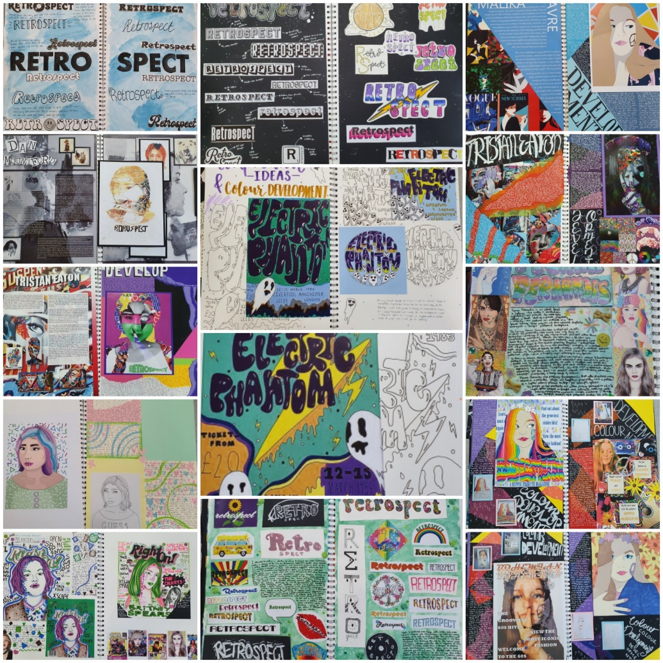
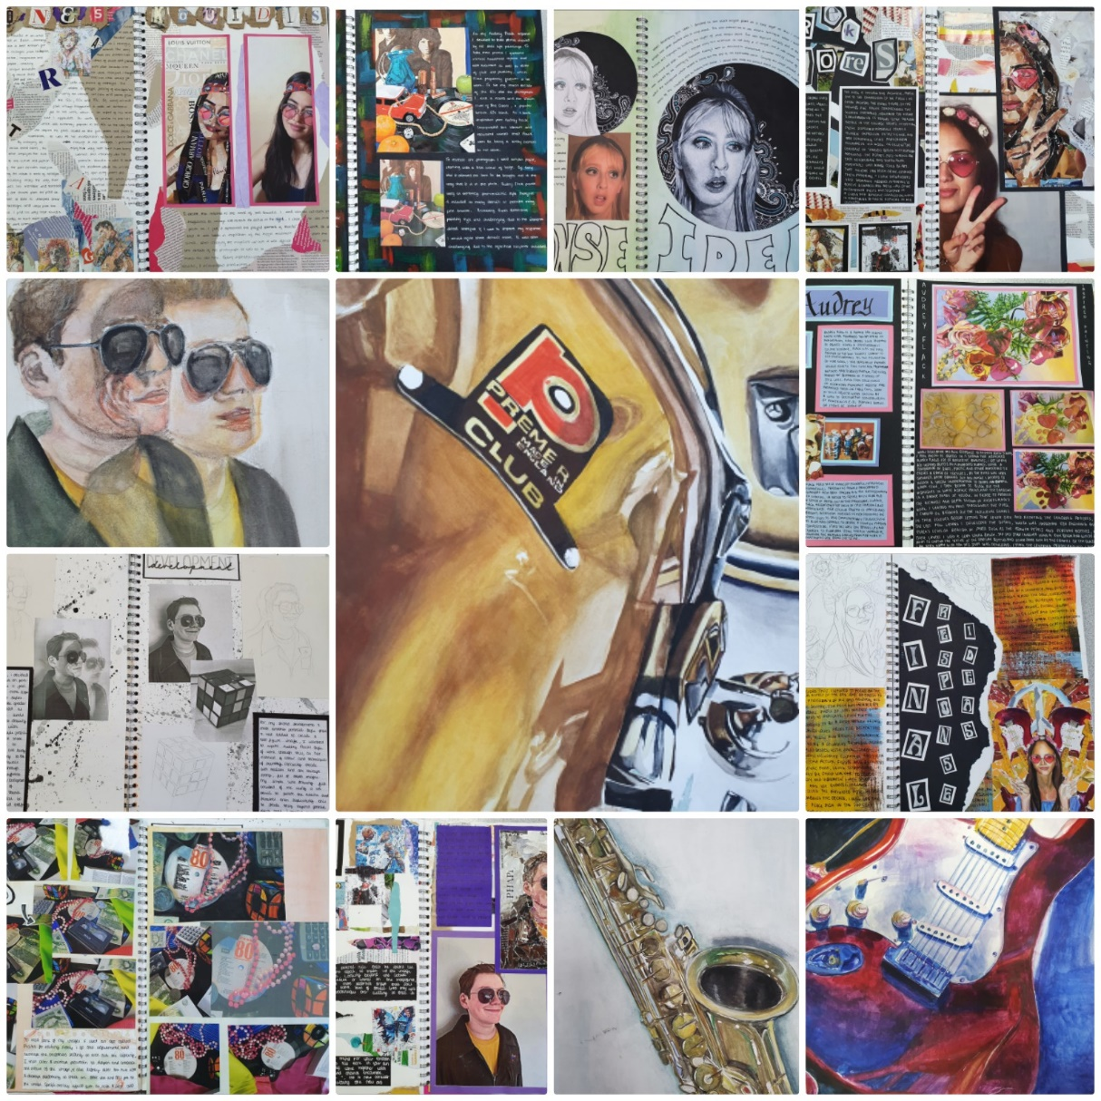
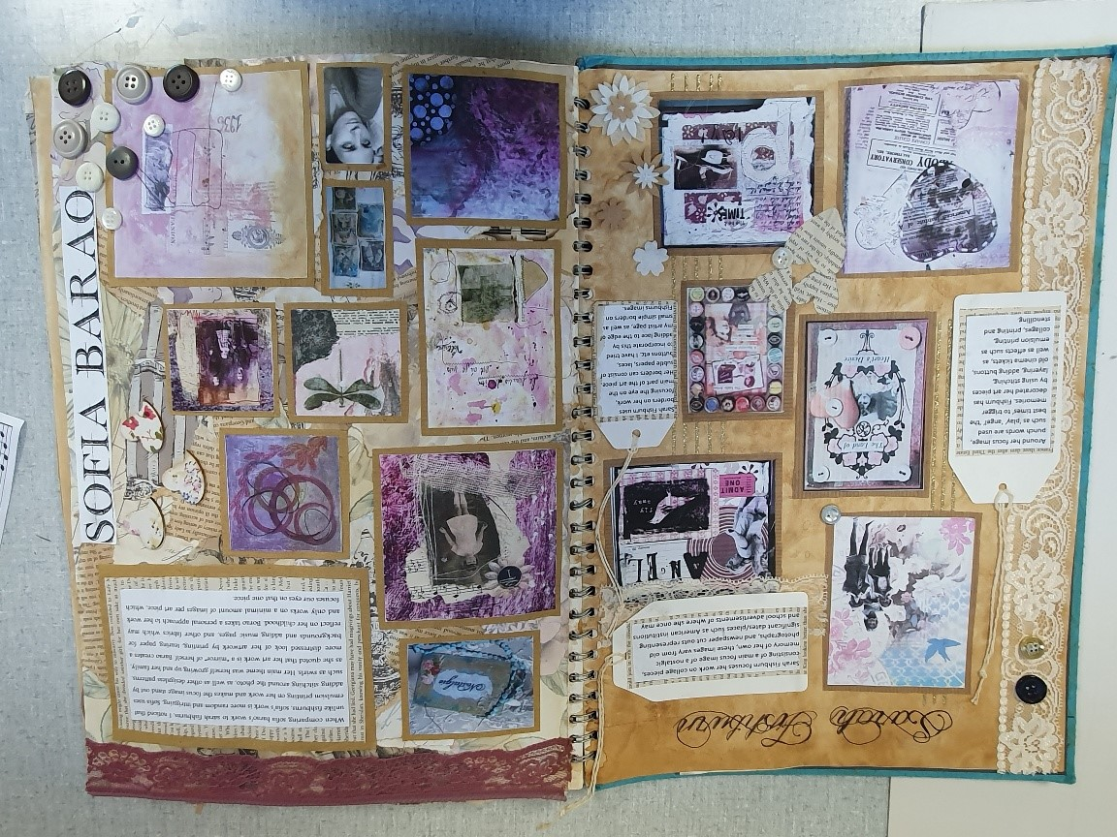

Slide 5
Unit 1- Personal Investigation 60%
Year 12/ 13
March - Jan
Hand in date is the 31st January
Personal Investigation project for a particular theme.
This project includes a focused essay 1000-3000 words which sets out your project goals, focused artists and leads to the development ofyour practical work and a final response.
You must show evidence of your personal work relating to your personal investigation theme.
You must show evidence of research and of investigating and developing ideas. This should include visual work and annotations or written work.
You must show evidence of developing and refining your ideas beyond the initial response.
Practical responses to the work of other artists, designers, craftspeople and photographers must show development in a personal way.

Slide 6
Unit 2 - Externally set assignment 40 %
Year 13
AQA issued Exam question paper will consist of a choice of eight questions to be used as starting points.
You are required to select one question.
You will be provided with exam papers on 1st of February, or as soon as possible after that date.
Preparatory period starts from 1st of February.
Learners consider their chosen starting point.
Preparatory work should be presented in a suitable format, such as presentation boards, canvases, journals, models and maquettes.
Supervised time – following the preparatory period, you must complete 15 hours of unaided, supervised time. In the 15 hours you must produce a finished outcome or a series of related finished outcomes, informed by your preparatory work.

Slide 7
Skills, techniques and process
Techniques and processes
Personal and meaningful response
Recording ideas
How to structure and organise sketchbooks
Different ways of researching and investigating ideas
How to handle a range of materials and processes
Creative experimentation of materials and ideas
Effective ways of exploring critical/ contextual materials
Different ways of analysing and responding to the work of others
Learners are introduced to appropriate media, materials, equipment and software related to their course and learn about how to present work effectively.
Different methods of Drawing fit for purpose
Recording ideas visually and through written formats
Photography
Collecting and sourcing imagery
Annotations
Exploring other subject specific media and techniques to record ideas.
Creating different ideas throughout the development phase
Making work which is informed by the work of others
Developing independent ideas
Making final pieces which reflect your development and journey through the projects
Using appropriate materials and techniques

Slide 8
FINE ART
Fine Art is a highly creative and exciting subject, which enables you to develop a portfolio of work, which is essential if you wish to pursue a career in Architecture, Fine Art or any other Design related university degrees. If you have an interest in Fine Art then this is the course for you, as it will engage you with in a wide range of artistic tasks in drawing, painting, mixed media, sculpture, installation, photography and printmaking.
A-Level Fine Art Personal Investigation themes
You are introduced to a variety of different themes such as - Body Language/ Sense of Place / Narrative / Real People / Urban Environment / Artist Techniques/ Shadows/ Food/ Water........

Slide 11
GRAPHIC COMMUNICTIONS
The graphics industry offers many exciting careers for the ambitious and hardworking. If you have an interest in Graphic Design then this is the course for you as it will give you rounded exposure to different aspects of Graphic Communication. Enabling you to develop skills in a variety of disciplines and demonstrate your understanding of these contexts. Your ideas and designs are produced using both traditional and new technologies.
A-Level Graphic Communications Personal Investigation themes
You are introduced to a variety of different themes such as - Sense of Place, Image and Text, Graphic Techniques, Typography, Illustration, Food, Logos and Branding.

Slide 14
TEXTILE DESIGN
Art-Textile Design is a dynamic course, which enables you to develop a creative portfolio of work, which is essential if you wish to pursue a career in Textile Design, Fashion Design or any other Design related university degrees. If you have an interest in Fashion and Textile Design then this is the course for you as it is a more fashion- based course. It is exciting and stimulating course introducing you to a variety of experiences; especially exploring a range of textile and fashion techniques.
A-Level Textile Design Personal Investigation themes
You are introduced to a variety of different themes, and you will develop work in response to an idea, issue, concept or theme.
Examples include Dramatic Costumes, Historical Periods, Inspirational Locations, Reflective Surfaces, Birds, Textile Techniques, Unorthodox Materials and Colour Abstraction.

Slide 15
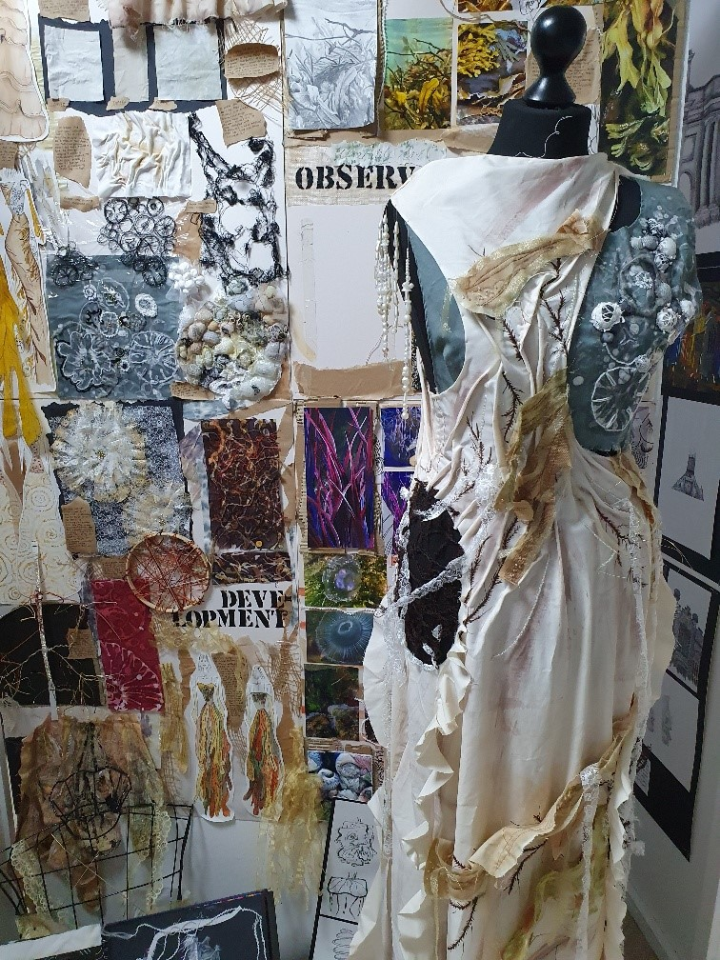
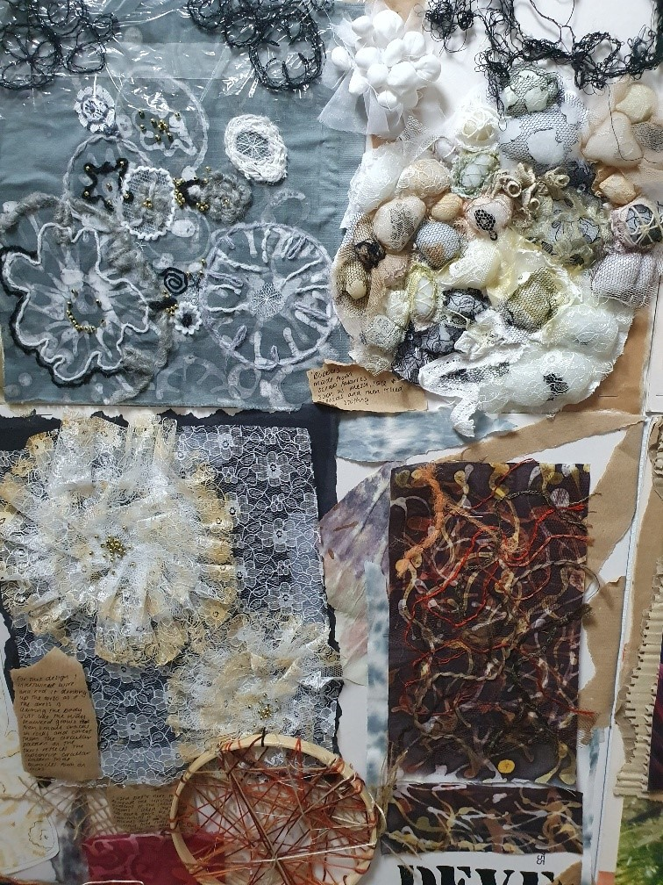

Slide 16
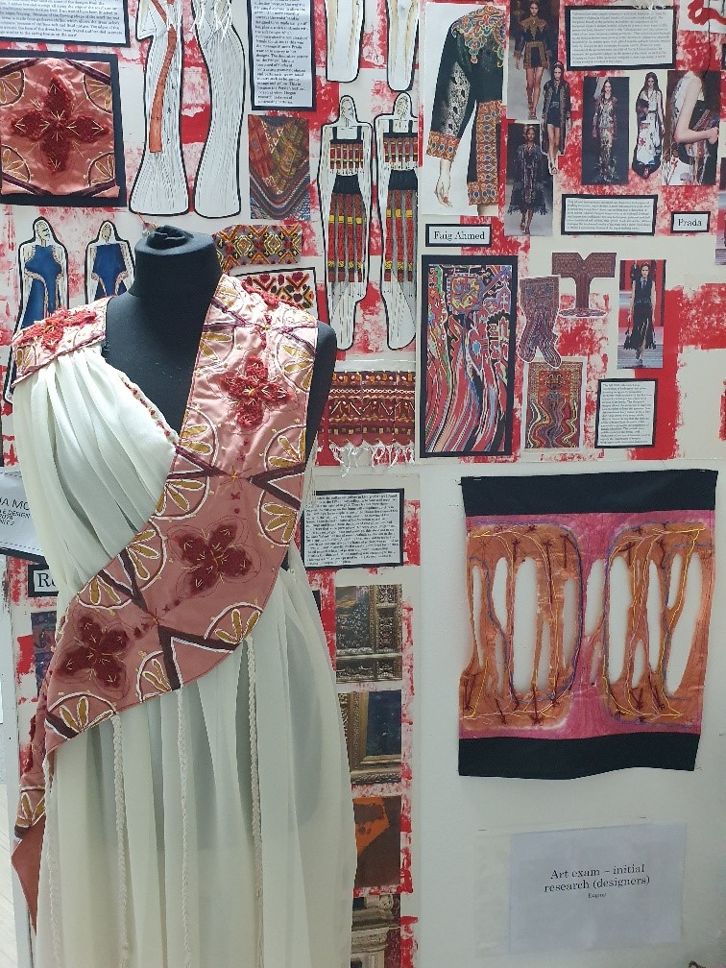

Slide 17
CAREERS
Each Art and Design course will give you the opportunity to develop a wide range of work to put together as a portfolio suitable for application to either a Foundation Course in Art and Design or a direct entry into Art and Design-based degree courses through UCAS.
Career routes Fine Art
Photographer, Journalist in Art/Media, Illustrator, Industrial Designer, Architect, Museum or Gallery Curator, Art Restoration, Art Conservationist, Interior Designer, Art Therapist, Film Production, Set Designer, Teaching or working as an artist.
Graphic Communications
Photography, Illustration, Graphic Communication, Game Designer, Photojournalism, Animation, Marketing, Packaging Design, Print Design, Branding and Advertising.
Textile Design
Textile designers create fabrics for fashion including printed, knitwear and woven fabrics. They can also design for interior furnishing companies or work freelance.

Slide 18
What else we offer?
Sixth Form Leadership Certificate
SIXTH FORM STUDIO SPACE TO WORK IN OUTSIDE OF LESSONS
SIXTH FORM VISIT TO LONDON AND LOCAL ART GALLERIES
VISITING ARTIST WORKSHOPS ACROSS SPECIALISMS
ROYAL ACADEMY SUMMER ONLINE EXHIBITION AND COMPETITION
LOCAL AND NATIONAL COMPETITIONS
Exhibitions – St Catherine’s Health Centre opening on the 4th of December and we are one of four school selected to be part of the Fresh Perspectives Exhibition at the Lady lever Art Gallery in the New Year ( Feb – March)

